Slide 1
Group 3 - lit

Slide 2
About US
Ladies In Tech stylized as LIT, is a group of consisting of 3 women from London and Oxford . Lola, Nini and Tasha are all aspiring to transition to a career in technology as a developer. The Sky Get In To Tech course provided us with the foundation, encouragement and confidence to embark on our technology careers .

Slide 3
The project
Create a blog from scratch using the foundations we have learnt in our 16 week course.
Our blog: ladiesintech.com
Inspired by our Get In To Tech scheme, we created a blog to help women who wish to transition in to a career in tech. The blog would list stories of women on their career journey in tech, learning tips, useful resources and list of key events.

Slide 4
RAINY DAY vs SUNNY DAY
More pages such as search internships, FAQ page
Security
Comments section under blog posts
Create an admin area
Share function for blogs
Newsletter/ email sign up
Select number of pages
Select functions
3 sprints maximum- Research, build, test

Slide 5
Sprint 1
Finalise blog name
Create Trello board
Research tech blog and gather tech stories and images
Research potential code needed

Slide 6
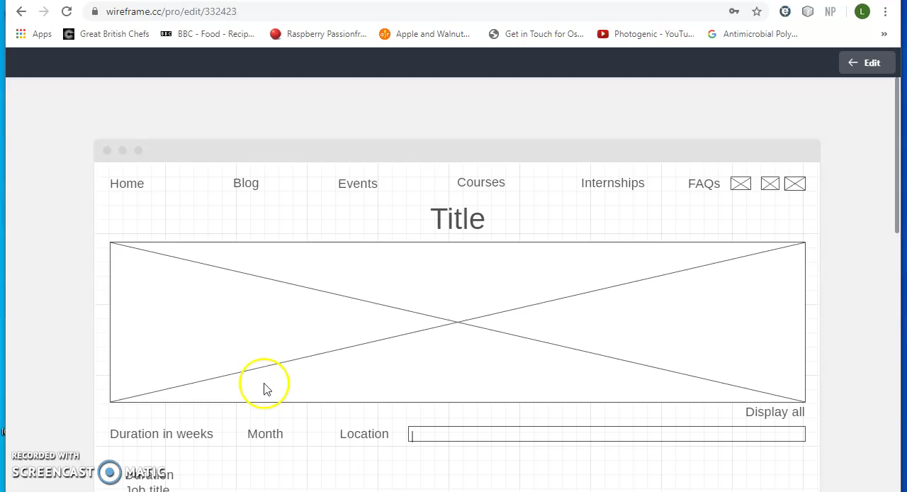
WIREFRAME

Slide 7
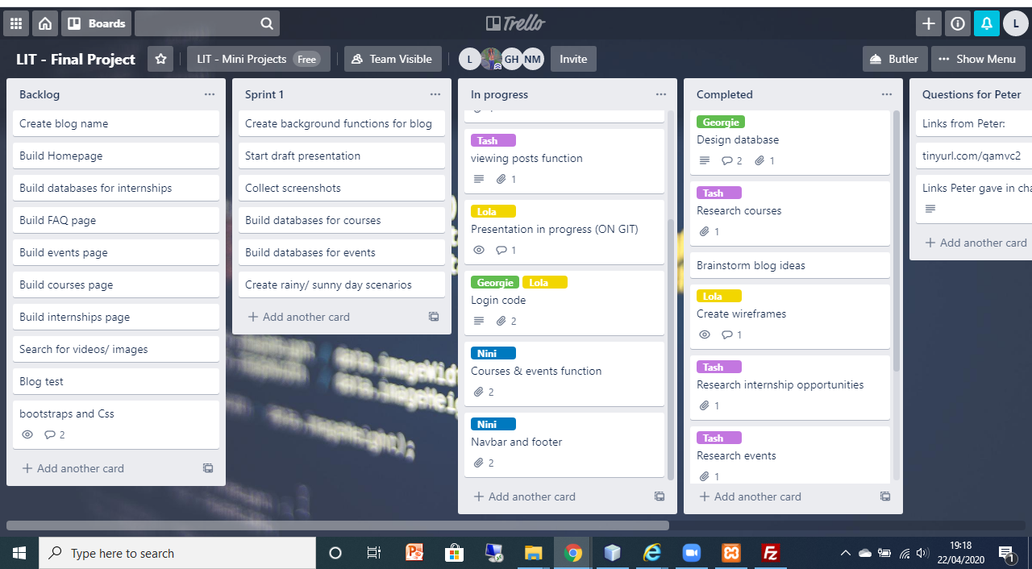
TRELLO BOARD

Slide 8
Sprint 2
Build backend pages
Build frontend pages
Research bootstrap/ styling

Slide 9
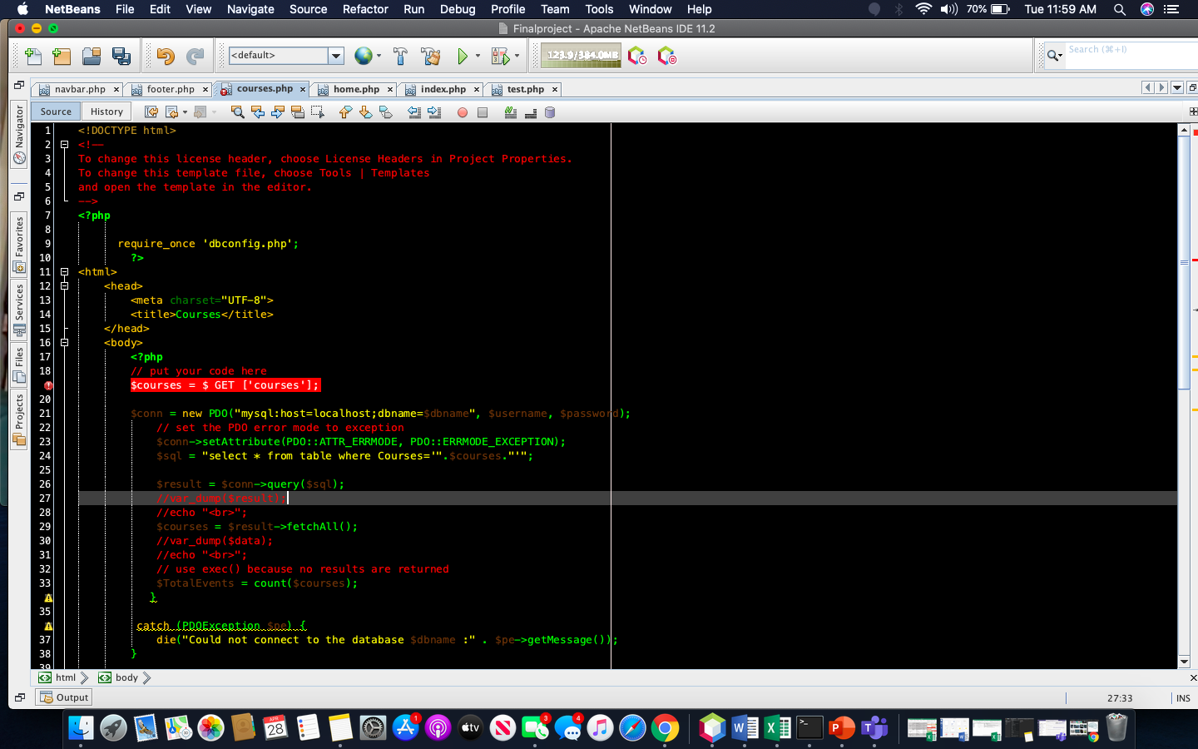
PAGE BUILD

Slide 10
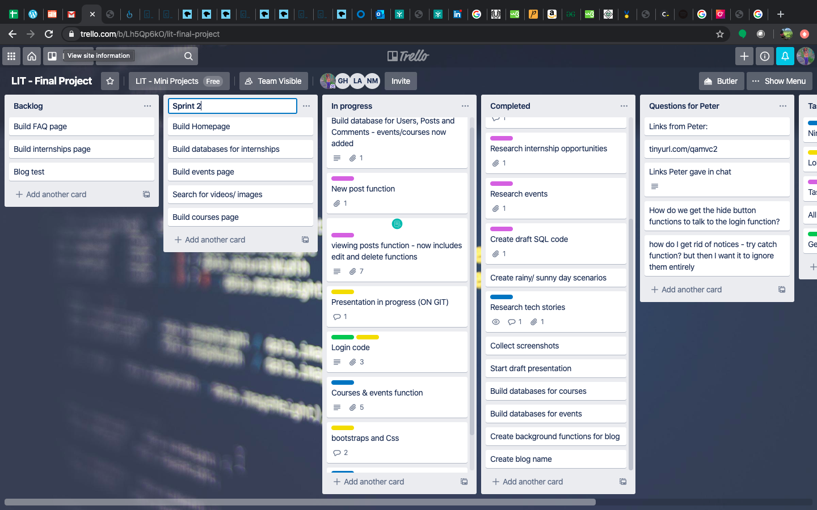
TRELLO BOARD – SPRINT 2

Slide 11
Sprint 3
Test pages
Test all pages link
Build presentation

Slide 12
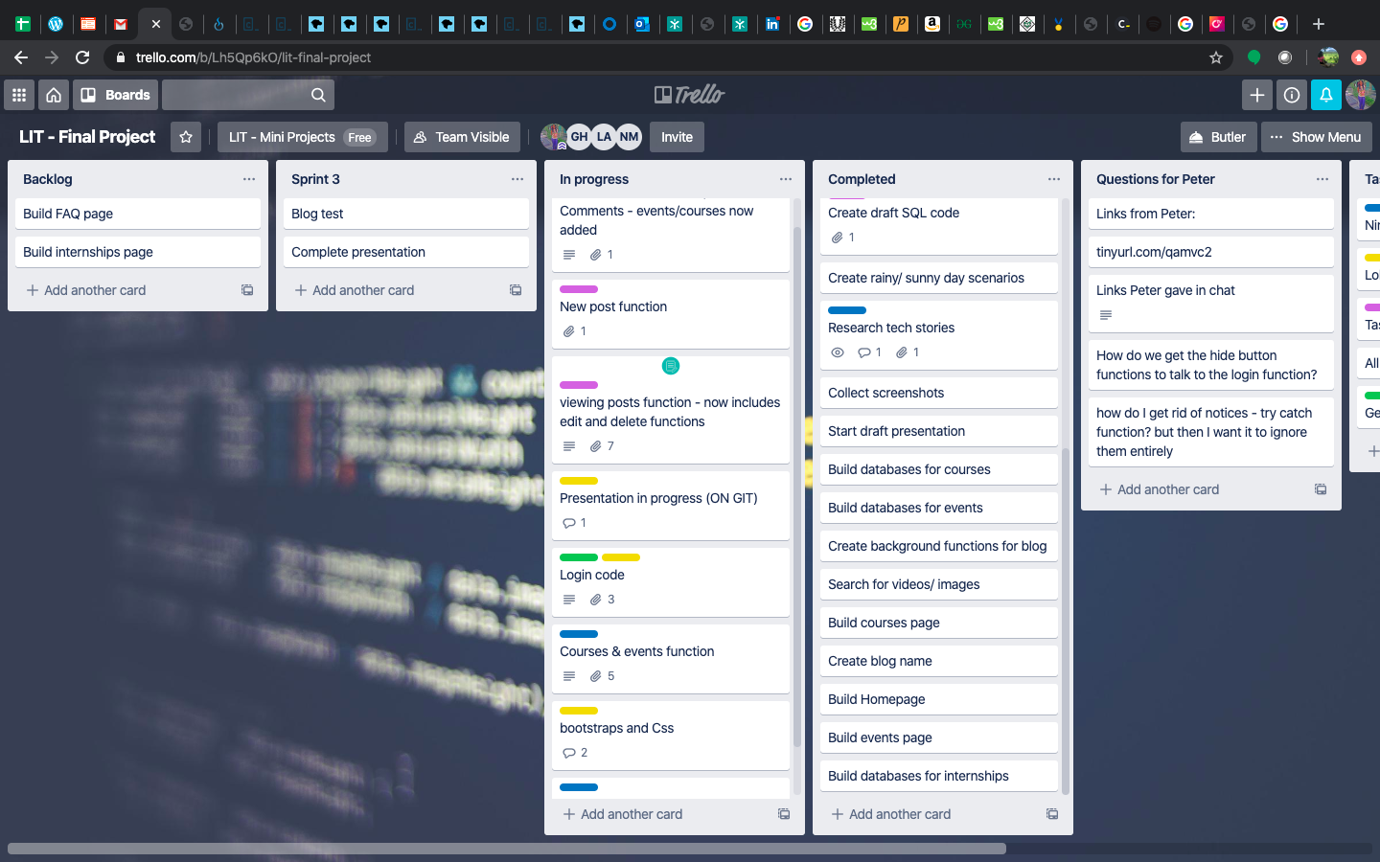
TRELLO BOARD – SPRINT 3

Slide 13
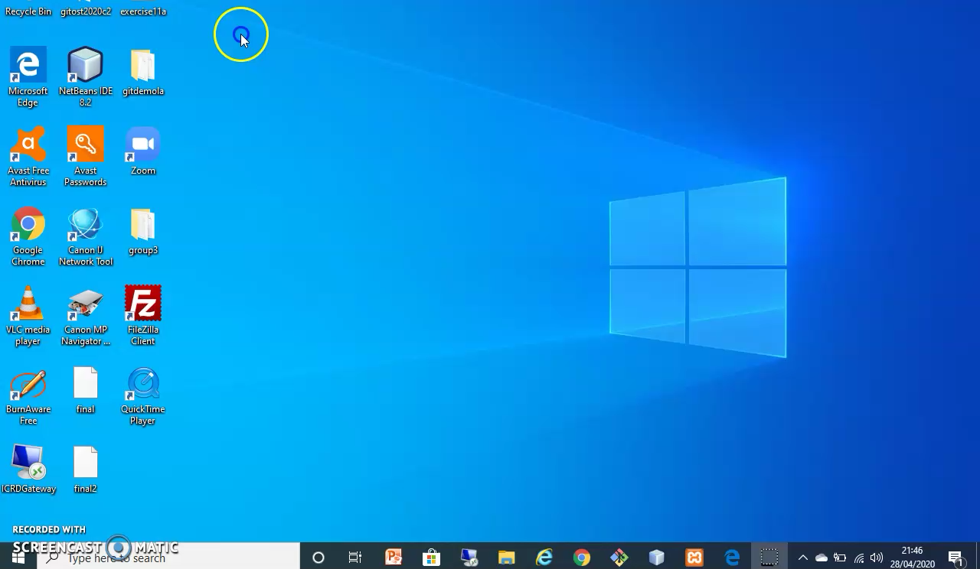
OUR BLOG

Slide 14
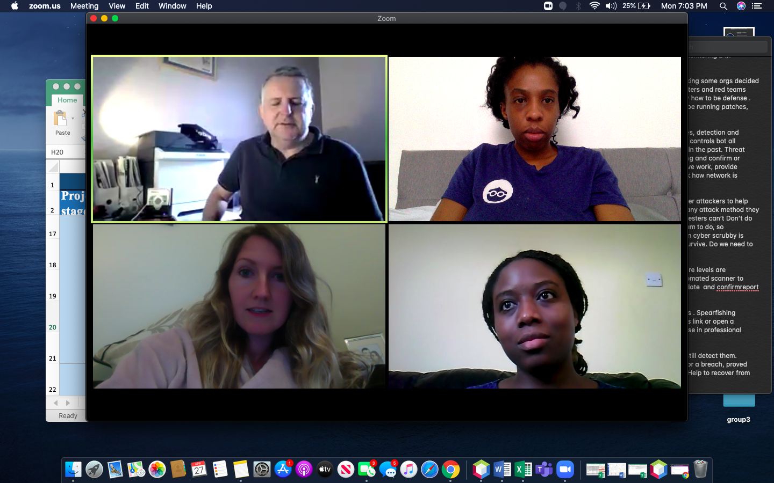
Challenges we faced
Team of 4 to team of 3
Time management
Distance
Technical issues
Communication
COVID lockdown

Slide 15
Thank you
From Lola, Tasha & Nini

